Slide 1
Computer Intelligence and Machine learning Group presentation
Machine learning techniques: K-Nearest Neighbors, Support Vector Machine, Deep Neural Network
Applications: To analyze if insider purchase/selling of stocks is a buy/sell signal
(Ronald to add a stock chart)

Slide 2
Summary – 3 key takeaways
1. To introduce a simple trading strategy which had a good hit rate of 70-80% based on our analysis
2. To briefly introduce various machine learning techniques (KNN, SVM, DNN) which were not covered in our lecture
3. To compare and explain the results of various techniques in our application; Highlight the limitations of each technique

Slide 3
Background of our application
“Insider trading” in our presentation means the purchase/selling of stocks by the board of directors or top management of a company
- It is legal and allowed in non-blackout period
Why it matters?
- Board of directors or top management usually have better knowledge of the company
- If they use their own money to buy/sell stocks, it signifies a vote of confidence
Our analysis aims to show when and how much an insider buy/sell for what type of stock would suggest a buy/sell signal for us

Slide 4
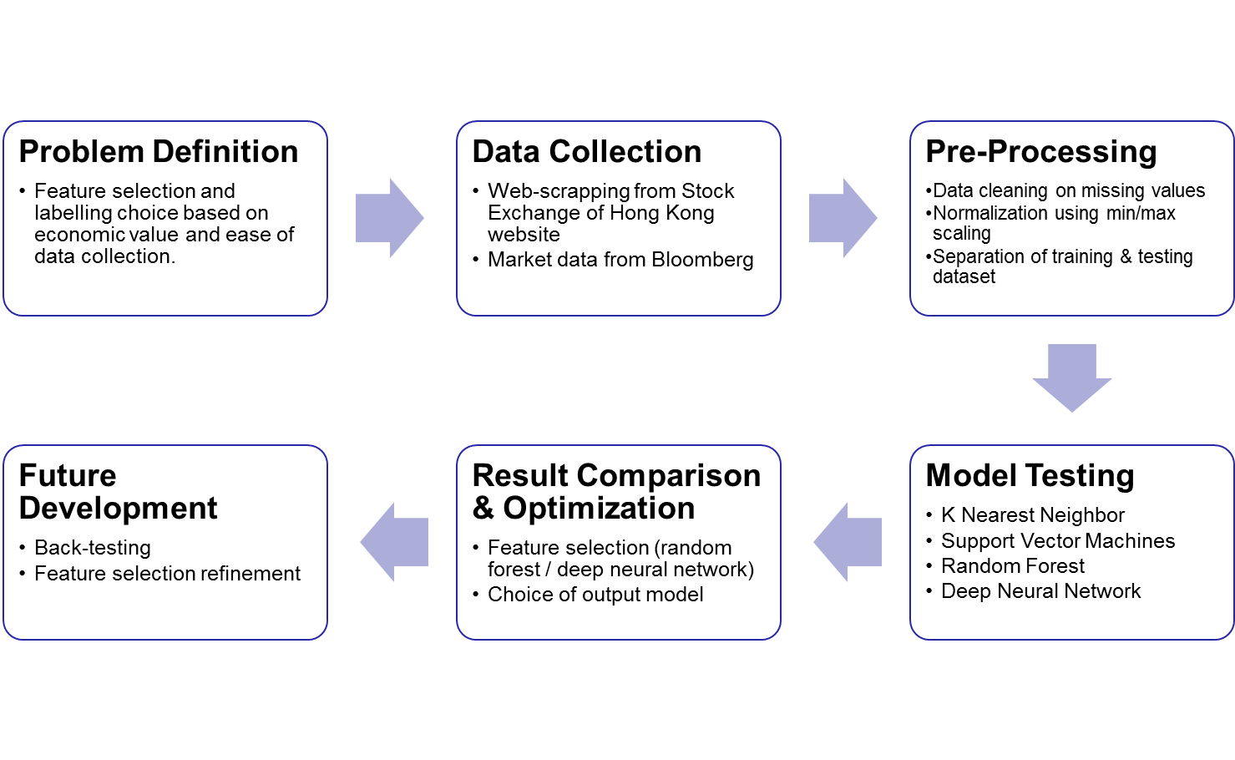
Analytical flow

Slide 5
Features and Labels Definition
Features
Name | Data Type | Description
side | Binary | 1 = Buy, -1 = Sell
return_t5 | Float | Price change 5 days before the transaction.
return_t30 | Float | Price change 30 days before the transaction.
vol_sh_out_pct | Float | Size of transaction relative to the total outstanding share in percentage.
stakepct | Float | Percentage of stake held by director in the company.
stake_pct_chg | Float | Percentage change of stake holding by the director. If the director does not own any shares before transaction, put as 0.
mkt_cap | Float | Market capitalization of the stock at the day of transaction. Unit: billions HKD.
prev_tran_num | Integer | Number of transaction from the same director trading the same stock on the same side (buy or sell) in the past.
hit_rate_5d | Float | If current side is Buy, return the number of positive 5d return on all previous buy transaction by the same director on the same stock, divided by “prev_tran_num”. Vice versa for sell.
hit_rate_30d | Float | Same as hit_rate_5d but replaced with 30d.
hit_rate_90d | Float | Same as hit_rate_5d but replaced with 90d.
Labels
Name | Data Type | Description
Return5d | Binary | 1 = positive 5 day return after transaction date, -1 = negative 5 day return after transaction date
Return30d | Binary | 1 = positive 30 day return after transaction date, -1 = negative 30 day return after transaction date
Return90d | Binary | 1 = positive 90 day return after transaction date, -1 = negative 90 day return after transaction date

Slide 6
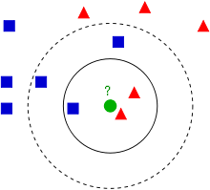
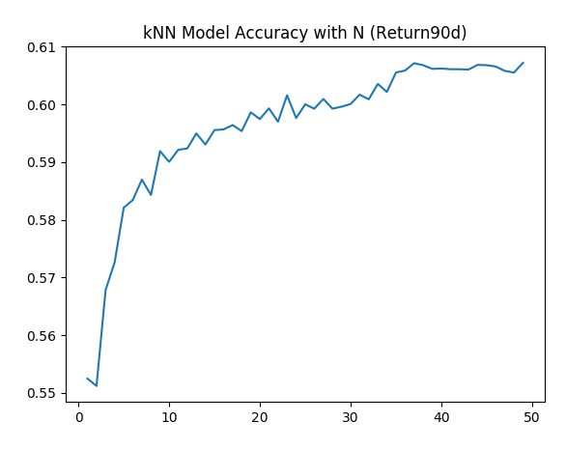
k-nearest neighbors (kNN)
Concept: an object is classified by a majority vote of its neighbor.
Model result: kNN prediction score increases as time horizon increases (90d>30d>5d) and as N increases. Best result from our model is when N=37.
Implication: Information value from director transaction may take time to realize.
Pros/Cons: very easy to use and fast, but no information on feature importance unless we solve a search problem to identify the optimal sub-set of features.
Output Label | kNN Score
Return5d | 54.2
Return30d | 58.1
Return90d | 60.7
Source: Wikipedia

Slide 7
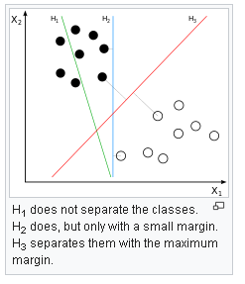
Support Vector Machine (SVM)
Concept:
  find out a boundary (hyperplane) that maximizes the distance between classes.
  Map the data into a higher dimensional space if boundary is not linear, a choice of mapping function (kernel) is required.
Model result:
  Prediction score increases as time horizon increases (90d>30d>5d)
  Polynomial kernel works better than others
  Gamma (radius influence) works well with default setting (1/#features)
Source: Wikipedia
Output Label | SVM Score
Return5d | 56.2
Return30d | 59.1
Return90d | 61.5
Kernel Choice | SVM Score (Return90d)
Linear | 57.6
Poly | 62.7
RBF | 61.5
Sigmoid | 51.7
Gamma | SVM Score (Return90d)
0.01 | 49.3
0.1 | 62.6
1 | 60.8

Slide 8
Deep Neural Network (DNN)
xxxxx

Slide 9
Comparison of results
Table to compare the score of various techniques
Explanation of our results

Slide 10
Limitations of our analysis
It may not be executed perfectly as we may need to see the insider buying at least a few days first before we will follow
Xxxx
Xxxxx
Xxxxx
xxxx

Slide 11
Alternative video presentation
Video to briefly describe K-Nearest Neighbour
Link and QR code to our youtube video:

Slide 12
Live demo on our application
To show how to find the insider purchase/selling data on HKEx
Apply the data as inputs in our algorithm
Generate Buy or no-Buy signal

Slide 13
References and sources
Historical insider purchase data: Hong Kong Exchange (www.hkexnews.hk)
Pricing data: Bloomberg
xxxx
Xxxx
xxxx

